Slide 1

Module 1 - Video 1.3
The Waze data structure

Slide 2
JSON
XML
{ "items": [
"{item1": "value1"},
"{item2": {
"subitem1": "value2.1"
"subitem2": 22
"subitem3": "value2.3"
},
{"item3": 3}
]
}
<items> <item1> value1 </item1>
<item2> <subitem1> value2.1 </subitem1> <subitem2> 222 </subitem2>
<subitem3> value2.3 </subitem3> </item2>
<item3> 3 </item3> </items>
Notes:
Basically, a data structure is a way to organize data.
You can organize it as tabular, commonly used in spreadsheets, or nested, which is the way that Waze data is structured.
It comes as a JSON or XML. They carry the same information, but with a different semantics.
Here we have three items. The first is a string, the second a list with subitems and the third just a number.
You can see that JSON uses braces and brackets whereas XML uses what we call, tags.
Let’s understand how Waze data that we see on maps are structured in those formats.

Slide 3
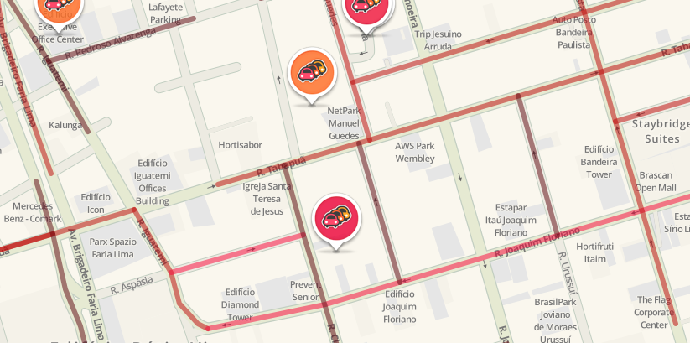
Map to alerts
Time
2018/09/20, 23h55
Address
R. Claudomiro Amazonas, São Paulo, Brasil
Type
Jam: stand-still traffic
Location
Latitude: -23.585318
Longitude: -46.679824
…
Notes:
This is an example of a jam alert in São Paulo.
It has, time, address, type and location.

Slide 4
Data to CSV Comma Separated Value
Time
2018/09/20, 23h55
Address
R. Claudomiro Amazonas,
São Paulo, Brasil
Type
Jam: stand-still traffic
Location
Latitude: -23.585318
Longitude: -46.679824
Notes:
Tabular most common data structure.
The one that we use everyday on spreadsheets and tables.
So, those 4 informations, can be easily understood as a row in a table.

Slide 5
Data to CSV Comma Separated Value
Time
2018/09/20, 23h55
Address
R. Claudomiro Amazonas,
São Paulo, Brasil
Type
Jam: stand-still traffic
Location
Latitude: -23.585318
Longitude: -46.679824
time | country | city | street | type | subtype | lat | lng
2018-09-21 13:29:00:000 | BR | São Paulo | R. Claudomiro Amazonas | JAM | JAM-STAND- STILL-TRAFFIC | -23.585318 | -46.679824
Notes:
You can notice that some of the information, such as address where split in three columns, country, city and address.
This happens because of the hierarchy of data. There are several cities in a country and several streets in a city. So, splitting the data like that makes it easier to query all the streets on a city.
Usually, this type of tabular structure is represented by a CSV

Slide 6
Data to CSV Comma Separated Value
Time
2018/09/20, 23h55
Address
R. Claudomiro Amazonas,
São Paulo, Brasil
Type
Jam: stand-still traffic
Location
Latitude: -23.585318
Longitude: -46.679824
time | country | city | street | type | subtype | lat | lng
2018-09-21 13:29:00:000 | BR | São Paulo | R. Claudomiro Amazonas | JAM | JAM-STAND- STILL-TRAFFIC | -23.585318 | -46.679824
time, country, city, street, type, subtype, lat, lng
2018-09-21 13:29:00:000, BR, São Paulo, R. Claudomiro Amazonas, JAM, JAM-STAND-STILL-TRAFFIC, -23.585318, -46.679824
Notes:
CSV stands for Comma Separated Value.
Each value in a row is separated by commas and a new row is given by new line.

Slide 7
Data to XML eXtensible Markup Language
Time
2018/09/20, 23h55
Address
R. Claudomiro Amazonas,
São Paulo, Brasil
Type
Jam: stand-still traffic
Location
Latitude: -23.585318
Longitude: -46.679824
Notes:
But, you can also structure the same data as a XML, which stands for eXtensible Markup Language.

Slide 8
Data to XML eXtensible Markup Language
Time
2018/09/20, 23h55
Address
R. Claudomiro Amazonas,
São Paulo, Brasil
Type
Jam: stand-still traffic
Location
Latitude: -23.585318
Longitude: -46.679824
<title> alert </title> <pubDate> Thu Sep 20 23:55:00 +0000 2018 </pubDate>
<georss:point> -23.585318 -46.679824 </georss:point> <linqmap:type> JAM </linqmap:type> <linqmap:subtype> JAM_STAND_STILL_TRAFFIC </linqmap:subtype> <linqmap:street> Av. Claudomiro Amazonas </linqmap:street>
<linqmap:city> São Paulo </linqmap:city>
<linqmap:country> BR </linqmap:country>
Notes:
As you can see, each information is between tags with its name.
The time becomes pubDate,
Location a georss: point tag,
and the rest a tag with linqmap two colons and the name.
This is the actual Waze data tag structure, so, the georss and linqmap are part of their own nomenclature for data.

Slide 9
Data to JSON JavaScript Object Notation
Time
2018/09/20, 23h55
Address
R. Claudomiro Amazonas,
São Paulo, Brasil
Type
Jam: stand-still traffic
Location
Latitude: -23.585318
Longitude: -46.679824
Notes:
Finally, JSON or JavaScript Object Notation are also a way to structure this information.

Slide 10
Data to JSON JavaScript Object Notation
Time
2018/09/20, 23h55
Address
R. Claudomiro Amazonas,
São Paulo, Brasil
Type
Jam: stand-still traffic
Location
Latitude: -23.585318
Longitude: -46.679824
{ "startTime": "2018-09-20 23:55:00:000",
"endTime": "2018-09-20 23:56:00:000",
"alerts": [
{"country": "BR",
"city": "São Paulo",
"street": "R. Claudomiro Amazonas",
"location": {"x": -46.679824,"y": -23.585318},
"type": "JAM",
"subtype": "JAM_STAND_STILL_TRAFFIC"}
]
}
Notes:
JSONs are usually lighter and easier to read.
Here, TIme becomes two items: StartTime and EndTime with one minute difference.
The rest of data comes nested in an item called alerts.
The braces represent an object and the brackets represent an array of objects.
In the following videos we are just discussing the JSON data structure. It is easier to read and most software comes with a built-in implementation to read jsons.

Slide 11
Full Structure
{
"jams": [ … ],
"alerts": [ … ],
"irregularities": [ … ],
"startTime": "2018-09-20 23:55:00:000",
"endTime": "2018-09-20 23:56:00:000",
"startTimeMillis": 1537487700000,
"endTimeMillis": 1537487760000
}
Notes:
The full Waze data structure is this one:
Jams, Alerts and Irregularities that carries an array of objects that are going to be discussed in the comming videos.
A start and end Time as a timestamp.
And a start and end time in millis, which is the time since first of january of nineteen seventy in milliseconds.

Slide 12
In the next videos...
{
"jams": [ … ],
"alerts": [ … ],
"irregularities": [ … ],
"startTime": "2018-09-20 23:55:00:000",
"endTime": "2018-09-20 23:56:00:000",
"startTimeMillis": 1537487700000,
"startTimeMillis": 1537487760000
}
Notes:
In the following videos, we are going to dive in the jams, alerts and irregularities structures.

Slide 13
See you in the next video!

